Slide 1
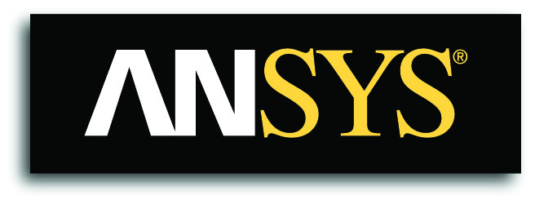
ANSYS Startup Program
Success Story Deck
Will James
11/30/16 - Aug 2018

Slide 2
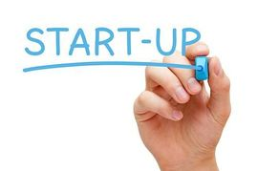
Success
Stories

Slide 3
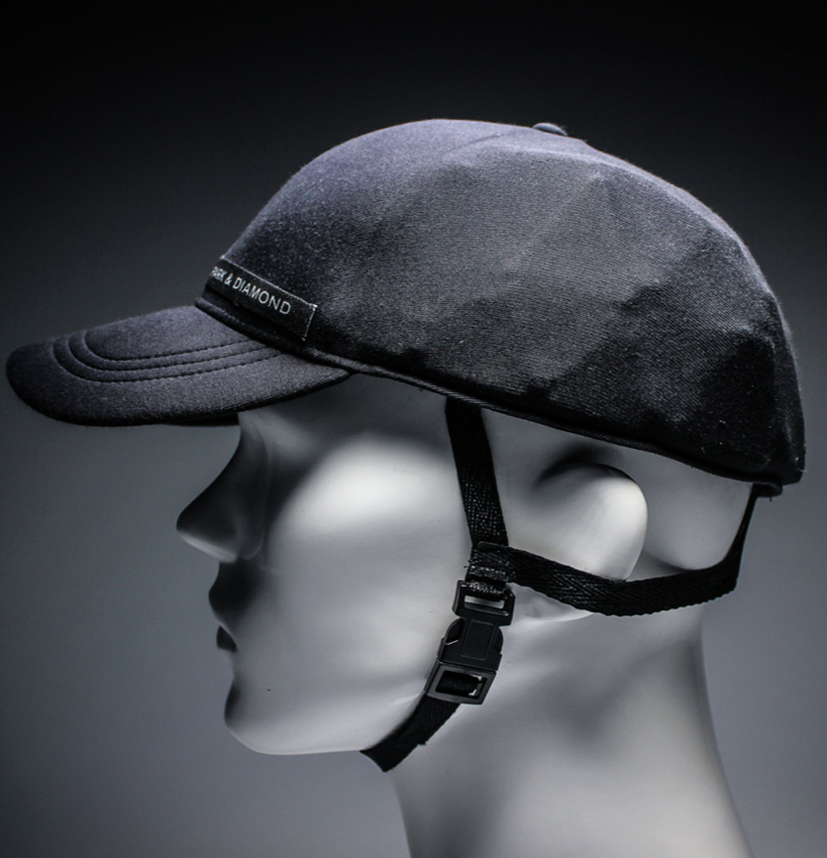

Success Story - Park & Diamond
OVERVIEW: Helmet industry.
PRODUCT: Cycling and skiing & snowboarding helmets.
SIMULATION: Used to design helmets as thin as a baseball cap and just as protective as traditional safety gear. Helmets can be collapsed, folded, rolled, and stuffed in a water bottle or pocket. Simulation is used for both product design and testing.
“ANSYS enabled us to design cutting-edge composite-materials under highly non-linear and complex multi-scale modeling and to design testing systems to validate our products. ANSYS software is a well-built, intuitive and powerful machine that makes me want to come into work every morning. I feel like we have such power at our fingertips without the several hours or days of debugging I’m used to with FEA - ANSYS is truly a pleasure to venture with.”
-Zakery Koster
Director of Engineering
Notes:
Paul

Slide 4
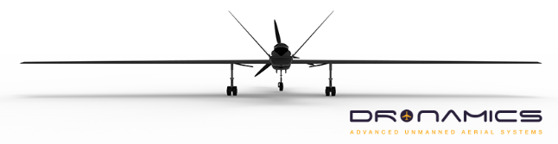
Success Story - DRONAMICS
OVERVIEW: Aircargo industry.
PRODUCT: Developer of cargo Unmanned Aerial Vehicles [UAVs].
SIMULATION: Used to design, analyze and highly optimize the aerodynamics of UAV, and its internal structure, to take full advantage of the lack of pilot cabin and life support systems, since in aviation, improved aerodynamics and lighter structures translate directly into improved fuel efficiency, and in cargo - fuel efficiency is the key to the competitiveness of a product.
“Since we became part of the ANSYS Startup Program, we managed to drastically reduce the design time and costs for our aerodynamic and structural components by using the ANSYS Fluids and ANSYS Structural tools...Our design time has been reduced by almost a half, when compared to traditional design methodologies involving prototyping and real-life tests and development costs have been reduced by an even larger margin.”
-Martin Zahariev BEng, MSc
Lead Aerodynamics Engineer
Notes:
Paul

Slide 5

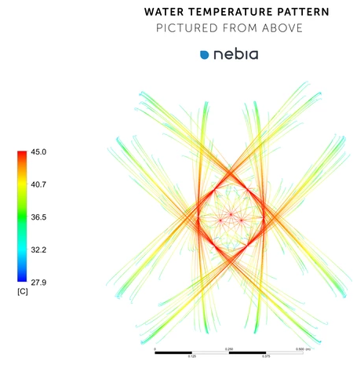
Success Story - Nebia
OVERVIEW: Aimed to create a showerhead that provided a more environmental and cost effective experience.
PRODUCT: Created H2MICRO technology which atomizes water into millions of droplets. Technology is leveraged in a showerhead.
SIMULATION: Used to streamline the research and development process, greatly reducing the R&D timeline.
“If we didn’t have ANSYS, we would probably just build prototypes...ANSYS is a far more cost-effective and much faster way of simulating and testing different designs...As a startup company, ANSYS simulation has been incredibly valuable because it allows us to iterate quickly and use our time effectively.”
-Corey Murphey
Research & Design Engineer
Notes:
Paul

Slide 6

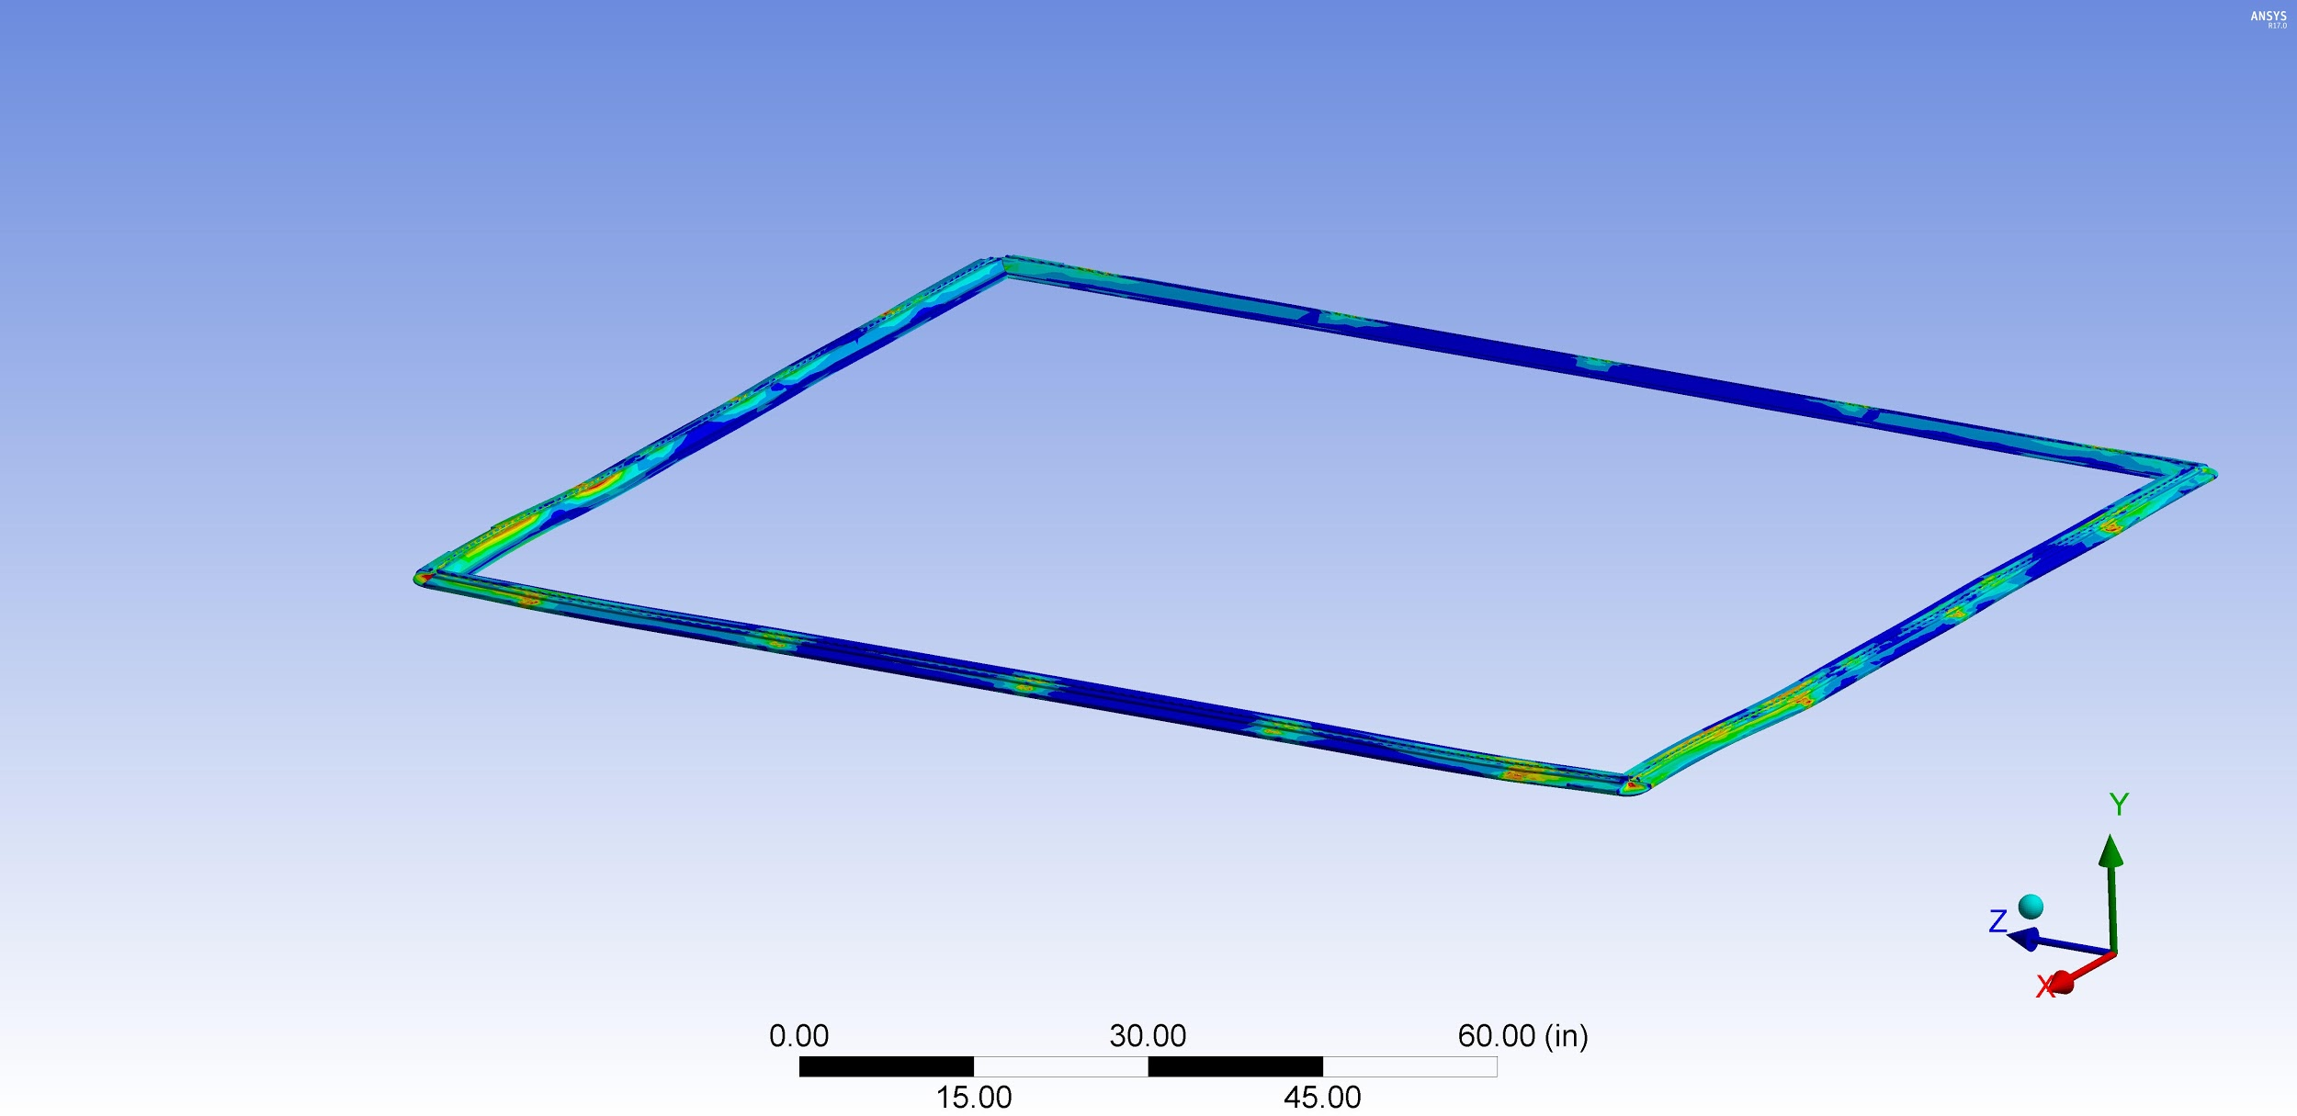
Success Story - Carbon Freight
OVERVIEW: Lightweighting is one of the most important trends in aerospace industry, but little attention has been paid to reducing the weight of cargo carried by planes everyday.
PRODUCT: Created flexible, lightweight cargo containers that are 18% lighter than traditional pallets.
SIMULATION: Used to understand and manage how pallets will react to diverse physical stress. Also, used to manage one of their biggest challenges, securing regulatory approvals from FAA and other organizations.
“We’ve been able to test different material thicknesses and fiber orientations without the time and expense of creating physical prototypes...we’re really happy with the accuracy of our simulations.”
-Glenn Philen
CEO

Slide 7
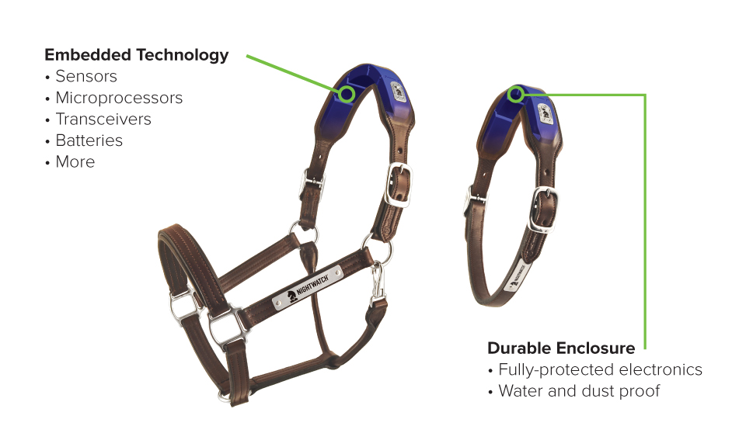
Success Story - Protequus
OVERVIEW: Colic kills 60,000 horses each year and it is estimated that 90% could be saved with rapid intervention.
PRODUCT: Created a device that collects biometric feedback in real time, alerting a horse owner when their animal might be in physical distress.
SIMULATION: Used to perfect the signalling capabilities of product to ensure it will operate reliably in real-world conditions.
“ANSYS HFSS has served as a kind of tuning fork...without simulation, I would have had to rely on guesswork and physical prototypes, which would be hugely time-consuming.”
-Jeffrey R. Schab
Founder & CEO

Slide 8
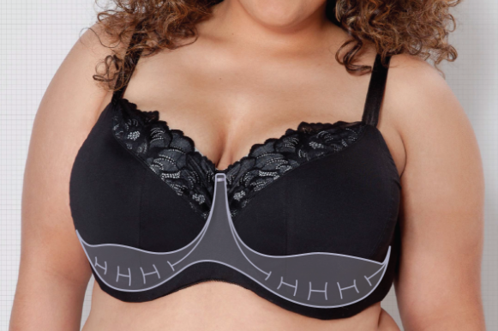
Success Story - TRUSST Lingerie
OVERVIEW: Bras are designed to provide support from above, via fabric shoulder straps. For larger-busted women this causes a lack of support and stress on the neck and shoulders.
PRODUCT: Created a bra that provides 80% of support from below, combining maximum lift with superior comfort. Done through the creation of replacing the underwire with an engineered system created from lightweight plastic materials.
SIMULATION: Used to study the structural mechanics and determined they could provide the same amount of support with less material allowing them to save significant manufacturing costs.
“Simulation is allowing us to test a broad range of materials under diverse thermal conditions which could be very expensive and time-consuming to accomplish if we relied on physical testing.”
-Kayla Geer
Industrial Engineer

Slide 9
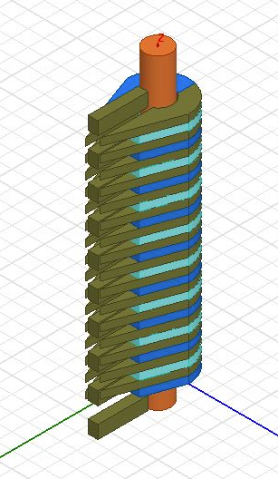
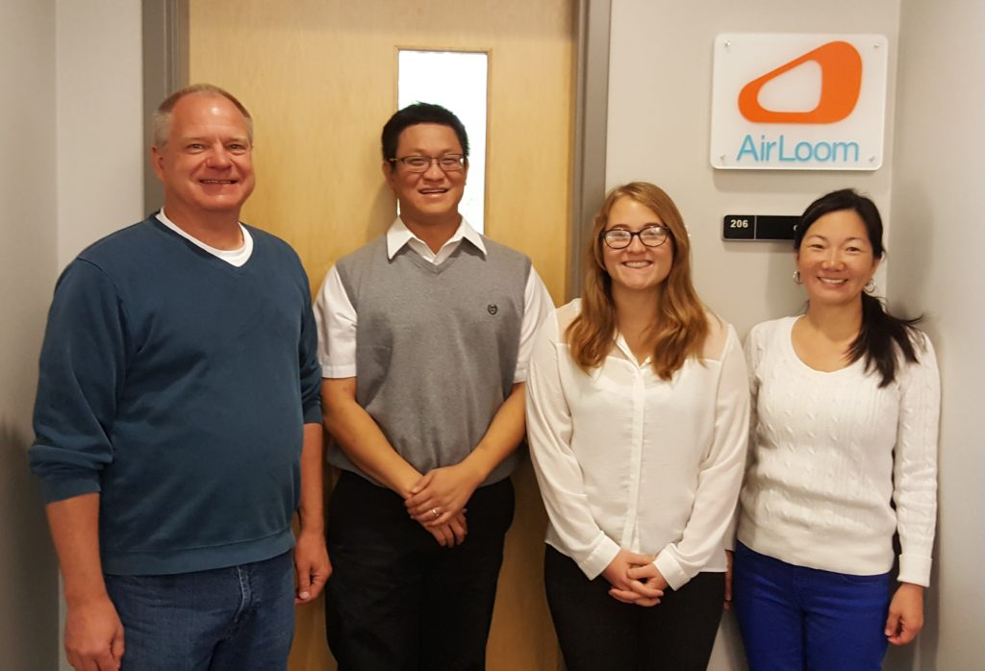
Success Story - AirLoom Energy
OVERVIEW: Simple, flexible, innovative design to capture wind energy at a fraction of the cost.
PRODUCT: Patented design, 23X reduction in the mass of Horizontal-axis wind turbine, resulting in dramatic reduction in manufacturing, transportation, maintenance and land costs.
SIMULATION: Used for product development and aided in securing a research grant.
“Not only has ANSYS software helped answer key product-development questions, but it’s given me the credibility to win funding. I recently received a research grant from the National Science Foundation, and a key element of my proposal was ANSYS simulation results showing my idea is feasible in the real world.”
-Robert Lumley
Founder & CEO

Slide 10
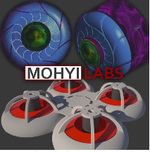
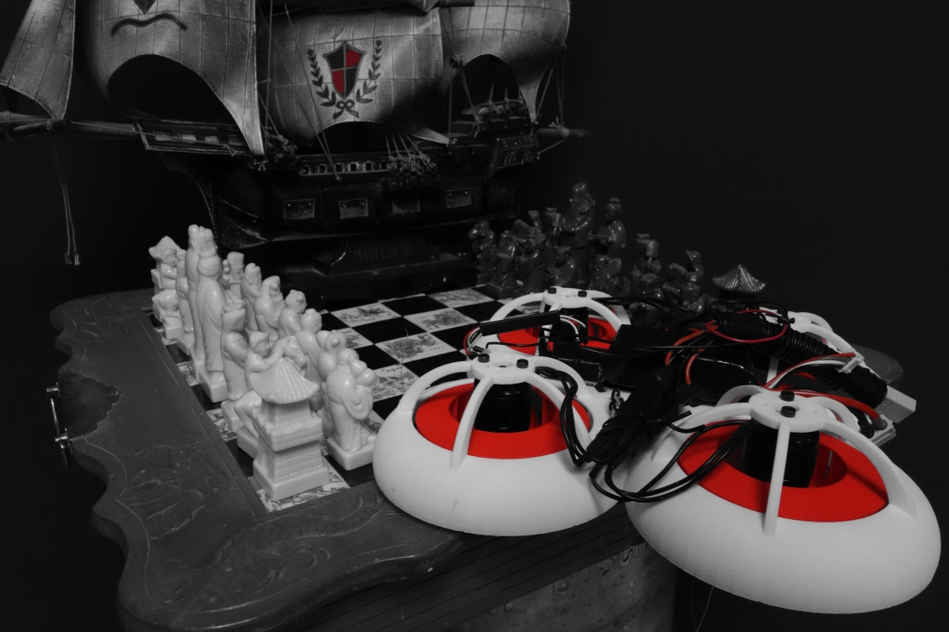
Success Story - Mohyi Labs
OVERVIEW: Set out to make a Bladeless Drone.
PRODUCT: In the process pioneered Ducted Counter-Vortex Radial Impeller Propulsion technology.
SIMULATION: Before simulation, design optimization required a considerable degree of detective work. Mohyi relied heavily on indirect methods to deduce the characteristics of the invisible forces at work.
“Using the CFX turbomachinery module, for the first time we have been able to directly observe and measure how well our counter-vortex geometry influences the airflow. ANSYS has eliminated the guesswork in our design iteration process.”
-John Mohyi
Inventor & CEO

Slide 11
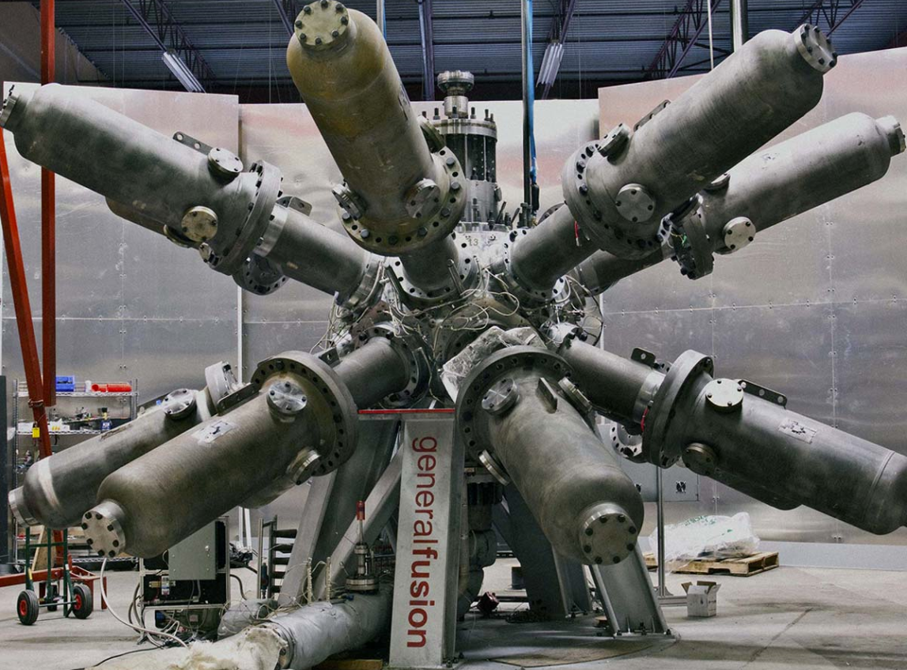
Success Story - General Fusion
OVERVIEW: Develop economically viable fusion energy. Key insight was that Magnetized Target Fusion, with the aid of modern electronics, materials, and advances in plasma physics, could provide a faster, lower cost, and more practical path to fusion power.
PRODUCT: Magnetized Target Fusion system uses a sphere filled with molten lead-lithium that is pumped to form a vortex.
SIMULATION: Enabled rapid iteration during the experimental phase of the project.
“ANSYS codes enabled General Fusion to simulate the dynamic loading of the structure from pressure generated by 14 large, high-speed pistons.”
-General Fusion

Slide 12

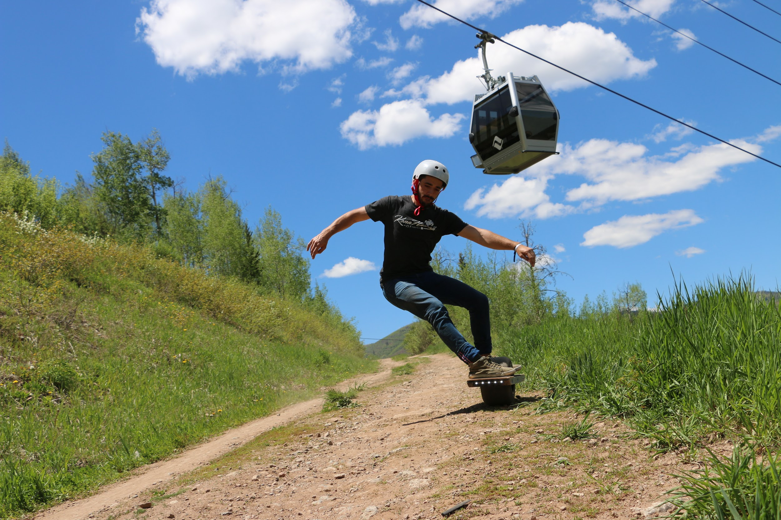
Success Story - OneWheel
OVERVIEW: Combine the practical necessity of moving around an urban environment with the thrill of board sports. Create a product that is equally at home on pavement, grass, dirt, or sand.
PRODUCT: A motorized skateboard equipped with a single 11.5-inch tire and a battery-powered 2HP motor.
SIMULATION: The initial development was focused on building and testing physical prototypes, but now simulation is being used to refine and improve the product.
“We estimate that it costs about $10,000 to design, build and test a physical prototype. Now that we have access to ANSYS software, we can better predict performance in the real world - which means we are building far fewer prototype boards. In addition, we can work a lot faster.”
-Kyle Doerksen
Founder & CEO

Slide 13
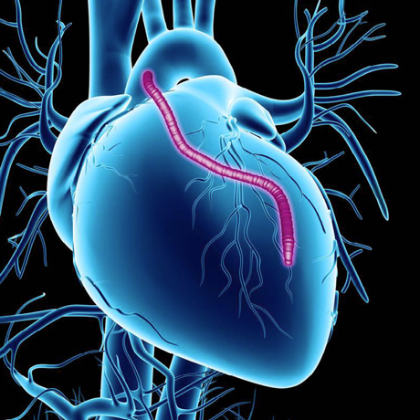
Success Story - Neograft
OVERVIEW: Each year more than 2 million patients worldwide undergo coronary artery bypass grafting. Within 18 months, 25% of the transplanted veins fail. After 5 years, that failure rate increases to 40%.
PRODUCT: Angioshield technology that creates a ‘scaffold’ of flexible polymer material around the transplanted vein. This scaffold improves both the vein’s strength and its geometric uniformity.
SIMULATION: Model different blood flows inside transplanted veins, as well as understand diverse mechanical forces that act on veins, such as the motion associated with a beating heart.
“Simulation provides a very visual way to tell our product’s story. There’s no way to see what’s actually happening inside a patient’s body. But, with simulation, we can replicate that environment and show Angioshield at work.”
-Mohammed El-Kurdi
Cofounder & Director of Research

Slide 14
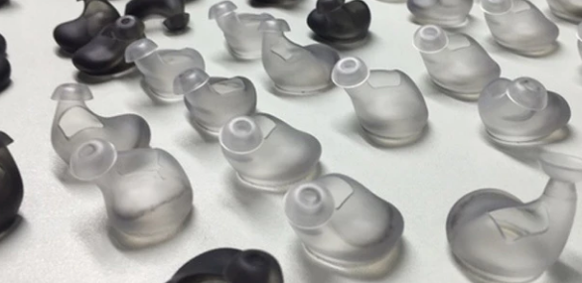
Success Story - Bragi
OVERVIEW: There are many devices that can do a variety of things and make lives easier. However, Bragi felt there was a lack of one device that can help in many areas of multi-tasking.
PRODUCT: One of Bragi’s products is The Dash, which is a type of personal assistant that fits in your ear. It allows a person to listen to music, dictate a message, measure steps, monitor heart rate, or answer a call while freeing up the rest of their body.
SIMULATION: Cut significant time and costs out of the development cycle for future product releases of The Dash and a variety of other solutions Bragi is working on.
“We can only prototype and test a finite number of configurations - and we need to account for a wide range of human bodies. Simulation is really the only way to move forward quickly and optimize our products across all conditions.”
-Nikolaj Hviid
CEO

Slide 15
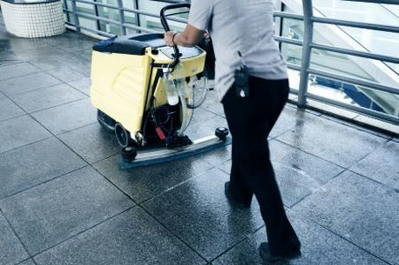
Success Story - Discovery Robotics
OVERVIEW: The janitorial occupation has one of the highest rates of injury and illness resulting in lost time at work. 25% of all injuries are directly related caused by floor maintenance tasks.
PRODUCT: Autonomous commercial floor cleaning robot that makes cleaning faster, safer, more efficient, and more affordable.
SIMULATION: Leveraged SpaceClaim to visualize concept options and component interactions quickly and easily.
“As a budget constrained startup company developing complex systems, the ANSYS Startup Program has been a real enabler for getting to a manufacturable product in minimal time.”
-Larry J. Williams, PhD.
Vice President and CTO

Slide 16
Success Story - PHAZR
OVERVIEW: Fourth-generation mobile internet technology is reaching its maturity. In 2017 the U.S. Federal Communications Commission (FCC) expected to debut a new standard for 5G. Verizon and AT&T have already publicly stated they will offer 5G service in 2017.
PRODUCT: Feasible 5G solution.
SIMULATION: Helping the team speed up its analysis and providing all-important design agility and flexibility.
“Without the power and agility provided by engineering simulation, we wouldn’t even be in the race to develop a feasible 5G solution.”
-Paul Gilliland
Business Development

Slide 17
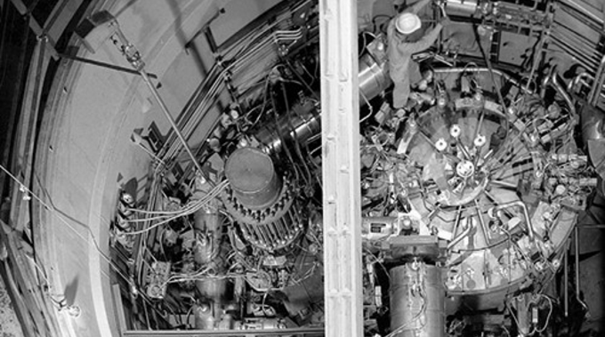
Success Story - Transatomic Power Corporation
OVERVIEW: They are leading advanced nuclear technology developer entering a major research and development phase.
PRODUCT: Developing a new nuclear reactor that is cleaner, safer, and cheaper than existing technologies. The company’s technology uses liquid, rather than solid, nuclear fuel, leading to better safety characteristics, higher fuel efficiency, and the potential for large cost savings.
SIMULATION: Leveraging for the computation work they are performing.
“The products and services that ANSYS provides are going to be critical to bringing our state-of-the-art advanced nuclear reactor technology closer to commercialization. We’re truly grateful for the opportunity to partner with a global leader in this field.”
-Dr. Leslie Dewan
Cofounder & CEO

Slide 18
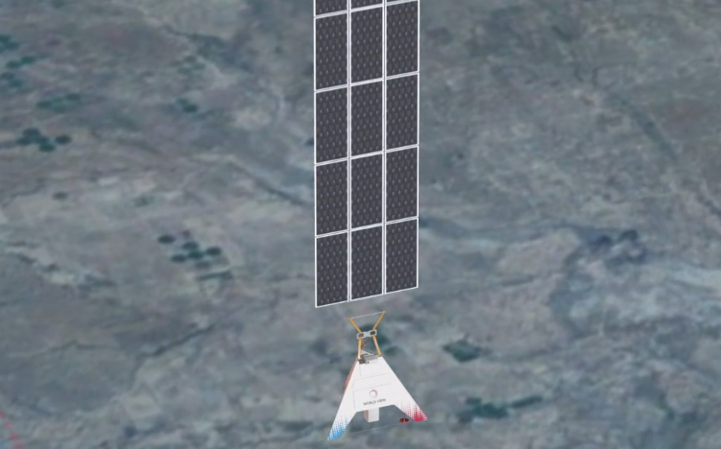

Success Story - World View Enterprises
OVERVIEW: Focused on opening an entirely new economy in the stratosphere with their high-altitude Stratollite vehicle.
PRODUCT: Stratollites offer all advantages of high-altitude balloons with the ability to fly a variety of trajectories (from circumnavigating the Earth to persistence over a specific location).
SIMULATION: Ensures Stratollites are designed to withstand the rigors of launching into, flying through, and coming back from the stratosphere.
“The ANSYS Startup Program has provided us a trusted and unparalleled simulation tool that enables innovation at the highest of levels.”
-Sebastian Padilla
Chief Engineer

Slide 19
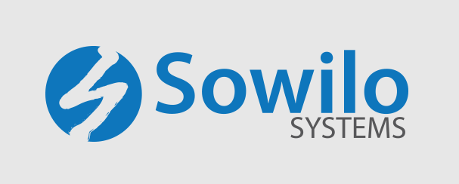
Success Story - Sowilo Systems
OVERVIEW: Passive-MEMS RF Technology.
PRODUCT: Miniaturized high performance filters for next generation communications.
SIMULATION: Leverages ANSYS HFSS for product design and optimization.
“ANSYS HFSS reduces our design costs by reducing design-change cycles and supports our innovations by precise electromagnetic solving.”
-Keqiang Wu
RF Engineer

Slide 20
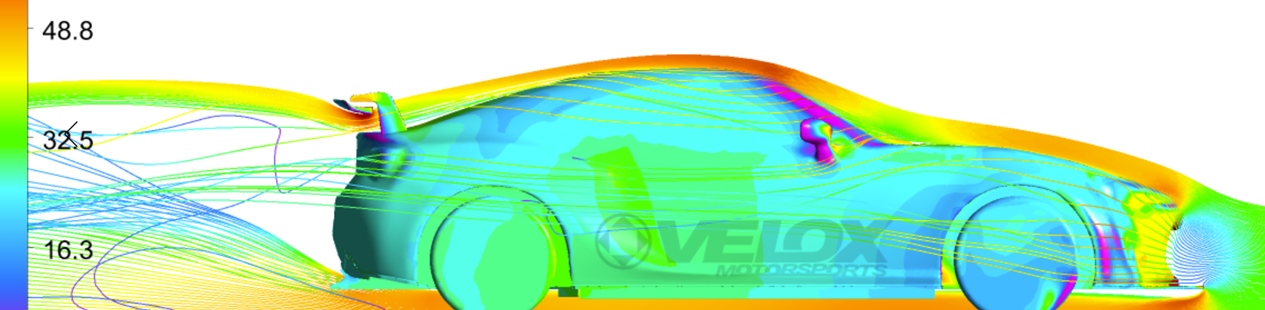
Success Story - Velox Motorsports
OVERVIEW: Revolutionizing the automotive components available to the aftermarket industry.
PRODUCT: Their extensive knowledge of the aftermarket industry and past experience in IndyCar, NASCAR, and WEC coupled with their use of ANSYS has allowed them to produce parts that outperform their factory counterparts.
SIMULATION: ANSYS has proven to be far superior to their previous simulation provider allowing them to speed up capabilities and improve overall accuracy.
“We use Computational Fluid Dynamics (CFD) for both internal and external flow analysis along with Finite Element Analysis (FEA) for structural components. We are now able to mesh more complex geometry with better end quality, in about half the time, giving us more confidence in our analysis and substantially improving our time to market.”
-Eric Hazen
CO-Owner

Slide 21
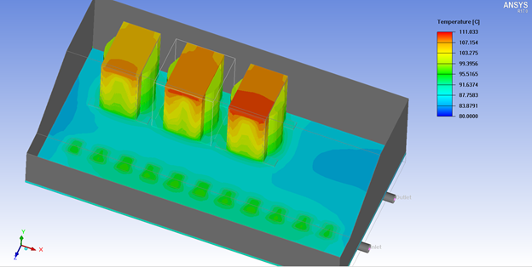
Success Story - Current Ways
“The ANSYS IcePak simulation showed a temperature profile that not only matched, in general terms, but showed us the hot-spots on the ferrite cores of our transformers and inductors to within 1 degree Celsius of a FLIR image of the actual working product.
The value of that kind of precision simulation just can’t be understated. We are now working with ANSYS Maxwell to show us what additional Eddy Current losses we will incur by placing metal heatsink brackets over the cores to better couple the cores thermally to our cold-plate.
The simulations are so robust that we should be able to determine the trade-off between additional Eddy Current losses caused by the metal heatsink brackets around the ferrite cores and the reduction in Rtheta they might provide.”
-Current Ways
OVERVIEW: A leading global electric vehicle charging solution provider. Focuses on reducing environmental pollution and creating a greener world through our dedication to customer-centric innovation.
PRODUCT: Developing electric vehicle charging solutions and electrical energy storage solutions.
SIMULATION: Thermal (ANSYS IcePak) and electromagnetic (ANSYS Maxwell) simulations of transformer components with impactful results.

Slide 22
